Slide 1
Data manipulation with R
Introduction to R syntax
Ángel Vergara Cruces

Slide 2
What is R?
It’s a program we can communicate with using commands
It’s a language that allow us to give instructions to the program
“Sadly, we, as humans, are used to speaking in ambiguity: we rely on the receiver to understand the context of our requests and figure out what the most likely desirable action is. When we ask our partner to get the salt, we don't expect her to return with a handful of salt: we expect her to understand that our intention is to use the salt container to sprinkle some salt on our dish and we need them to bring the container to us, filled with at least a minimum amount of salt.”
-The Bash Guide

Slide 3


What is R?
Install R (https://cran.r-project.org/)
and RStudio (https://www.rstudio.com/products/rstudio/download/)

Slide 4
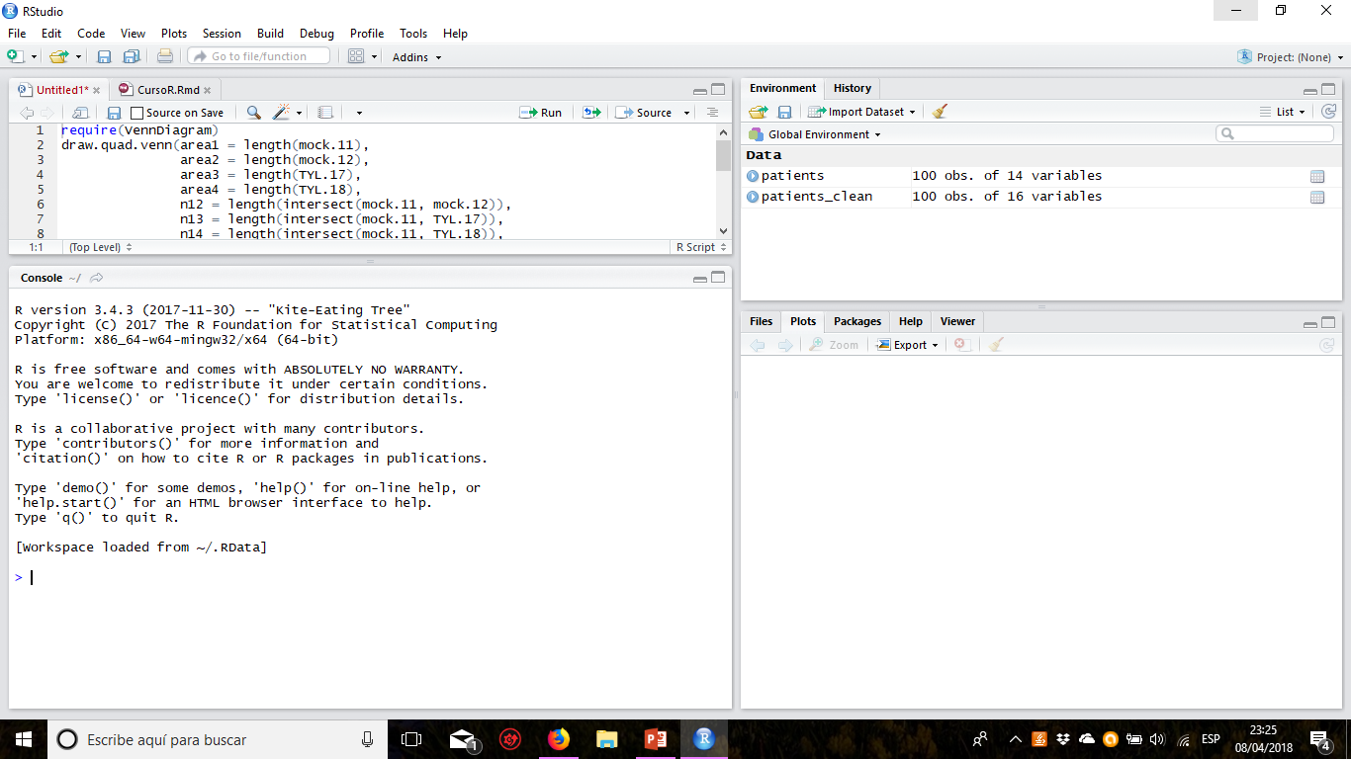
¿Qué es R?
Instalar R (https://cran.r-project.org/)
y RStudio (https://www.rstudio.com/products/rstudio/download/)

Slide 5

What is R?
Package: what’s a package?
install.packages(“mycoolpackage”)
library(“seqinr”)
Useful packages:
seqinr (opérate with sequences)
dplyr, magrittr, tidyr (tidyverse: data cleaning and data manipulation)
ggplot2
Repositories: CRAN and Bioconductor(https://bioconductor.org/install/)

Slide 6
Objects and functions
Objetcs (store the information)
Ex.: list of genes
mygenes
Functions (execute operations)
Ej.: search homologs
myhomologs
homolog(genes = mygenes)

Slide 7
Anatomy of a command
Prompt
Argument
Object the function is applied to
> homolog(genes = mygenes)
Name of the function

Slide 8
Anatomy of a command
Prompt
Argument
Object the function is applied to
> homolog(genes = mygenes,
species = “Arabidopsis thaliana”)
Name of the function

Slide 9
Objects are stored in variables
mygenes <- c(“ARF1”, “ARF2”, “CMT3”)
or
mygenes = c(“ARF1”, “ARF2”, “CMT3”)
This is the assignment operator and it is used to associate names to objects, so we can refer to them later in the code.

Slide 10
Anatomy of a command
Prompt
Argument
Object the function is applied to
>homolog(genes = mygenes,
species = “Arabidopsis thaliana”)
Los argumentos de una función se sitúan entre paréntesis y separados por comas
Name of the function

Slide 11
Classes of objetcs in R: “atomic” classes
Numbers: integer: 1 and numeric: 2,7
Words: character: “a”. We call a sucession of characters a string: “ACTTG”.
Logical: TRUE and FALSE

Slide 12
Types of objects in R
Vectors: contain objects of the same class
Lists: may contain objects of different class
Factors:
Matrices: tables with elements of the same class
Dataframes: tables with elements of different class (same class within each column)
“a”
“c”
“c”
“t”
1
2
5
67
“a”
1
“a”
“c”
“c”
“t”
1
2
5
67
Levels
“t”
“c”
“a”
“g”
3
6
0
6
4
10
47
32
8
Gene
Pos
Strand
“CMT3”
6
“+”
“AL1”
44
“-”
“PCNA”
32
“+”

Slide 13
Types of objetcs in R
Vectors: contain objects of the same class
c(“a”, “c”, “c”, “t”) c(1, 2, 5, 67)
Lists: may contain objects of different class
list(“a”, 1, c(“a”, “c”, “c”, “t”), c(1, 2, 5, 67))
Factors: store occurences from a given set
factor(c(“a”, “c”, “c”, “t”), levels = c(“a”, “c”, “g”, “t”))
Matrices: bidimensional vectors
matrix(c(3, 6, 47, 6, 4, 32, 0, 10, 8), nrow = 3, ncol = 3)
Dataframes: lists with objects of same length
data.frame(Gene = genes, Pos = positions, Strand = strand)

Slide 14
Coercion: force a category into another
Sometimes (willingly or not) we can change the class of an object. This is called coercion and it follows a series of rules.
Between numeric and character:
1 ↔ “1”
“a” → NA*
Between numeric and logical:
1 ↔ TRUE
0 ↔ FALSE
*NA or “Not Available” is introduced by R when the operation cannot be performed. We should try not to get Nas when applying a function

Slide 15
Types of objetcs in R
Vectors: contain objects of the same class
c(“a”, “c”, “c”, “t”) c(1, 2, 5, 67)
Lists: may contain objects of different class
list(“a”, 1, c(“a”, “c”, “c”, “t”), c(1, 2, 5, 67))
Factors: store occurences from a given set
factor(c(“a”, “c”, “c”, “t”), levels = c(“a”, “c”, “g”, “t”))
Matrices: bidimensional vectors
matrix(c(3, 6, 47, 6, 4, 32, 0, 10, 8), nrow = 3, ncol = 3)
Dataframes: lists with objects of same length
data.frame(Gene = genes, Pos = positions, Strand = strand)

Slide 16
Accessing elements within an object
Vectors: using brackets, we specify a vector of indices or logical (should the element be returned? y/n)
genes[1:3]; genes[c(TRUE, TRUE, TRUE, FALSE, FALSE)]
Lists: using brackets [] (to extract sublists) o [[]] (element itself)
my.list.of.genes[c(1:3, 5, 67)]; my.list.of.genes[[2]]
Factors: Just like a vector
mRNA.strand[1];
Matrices: using brackets, specifying row and column in that order:
allignment.matrix[1, 3]; allignment.matrix[1, ];
allignment.matrix[, 3];
Dataframes: just like matrices
bam.df.14dpi[1, c(1,7,8)]

Slide 17
We can also use names!
Vectors: using [“name”]
Lists: using $name. We can assign names with the function names()
names(my.list.of.genes) <- c(“C1”, “HopZ1A”, “AGO1”)
my.list.of.genes$C1; my.list.of.genes[[“C1]]; my.list.of.genes[“C1]
Factors: Just like a vector
mRNA.strand[1]
Matrices: using brackets, specifying row and column in that order:
allignment.matrix[“seq1”, “seq3”]; allignment.matrix[“Nicotiana”, ];
allignment.matrix[, “Reverse”];
Dataframes: listas con objetos de igual longitude
bam.df.14dpi[1, c(1,7,8)]

Slide 18
Some useful operations (mainly for vectors)
typeof(object) -> Which class is this object?
length(list) -> Number of elements
which(genes == “ARF1”) -> Indices of elements fulfilling a certain condition
table(vector) -> get the frequency of appearance each element
sort()
sum()
max(), min(), which.max(), which.min()
any(); all() -> Are any/all elements TRUE?

Slide 19
Operaciones con listas
We Access elements within a list using brackets [] (to extract sublists) o [[]] (element itself)
También podemos nombrar elementos y llamar con $nombre

Slide 20
Operaciones con matrices
Accedemos a elementos con [fila, columna]
También podemos nombrar filas o columnas y acceder con [nombre, name]

Slide 21
Operaciones con factores

Slide 22
Operaciones con dataframes!!
Podemos acceder a elementos de forma similar a matrices
Lo más común es tener columnas con nombre y referirnos a ellas como $nombre

Slide 23
The family of apply() functions
It’s used to apply the same function over the elements within an object:
apply(X = matrix, MARGIN = 1, FUN = sum) apply(matrix, 2, sum)
list <- lapply(list, s2c)
lengths <- sapply(list, length)
3
6
0
9
3
6
0
6
4
10
20
6
4
10
47
32
8
87
47
32
8
56
42
18

Slide 24
Suggested exercises!

Slide 25

Obtain help
From R:
help(“which”) -> Help page of the which() function. It contains all its arguments, what they do and which input is expected. It should have some examples at the bottom of the page, as well
??which -> Search for a term in the help pages
Google!!
A human

Slide 26

Resources
Mastering Software Development in R by Roger D. Peng, Sean Kross, and Brooke Anderson
https://bookdown.org/rdpeng/RProgDA/crash-course-on-r-syntax.html
Foro StackOverflow: https://stackoverflow.com/
Cursos de R y Ciencia de datos: https://www.datacamp.com/tracks/data-scientist-with-r
Introducción a R: https://bioinformatics-core-shared-training.github.io/r-crash-course/crash-course.nb.html
Manejo de tablas en R: http://bioinformatics-core-shared-training.github.io/r-intermediate/
Blogs dedicados a R: https://www.r-bloggers.com/

Slide 27
Coming soon…
Reading files in R (FASTA; tables in txt, csv, excel)
Cleaning and formatting data (tidyverse)
Managing tabular data in R
Piping
Plotting with ggplot2
Other stuff: flow control and creation of functions, shiny

